Slide 1
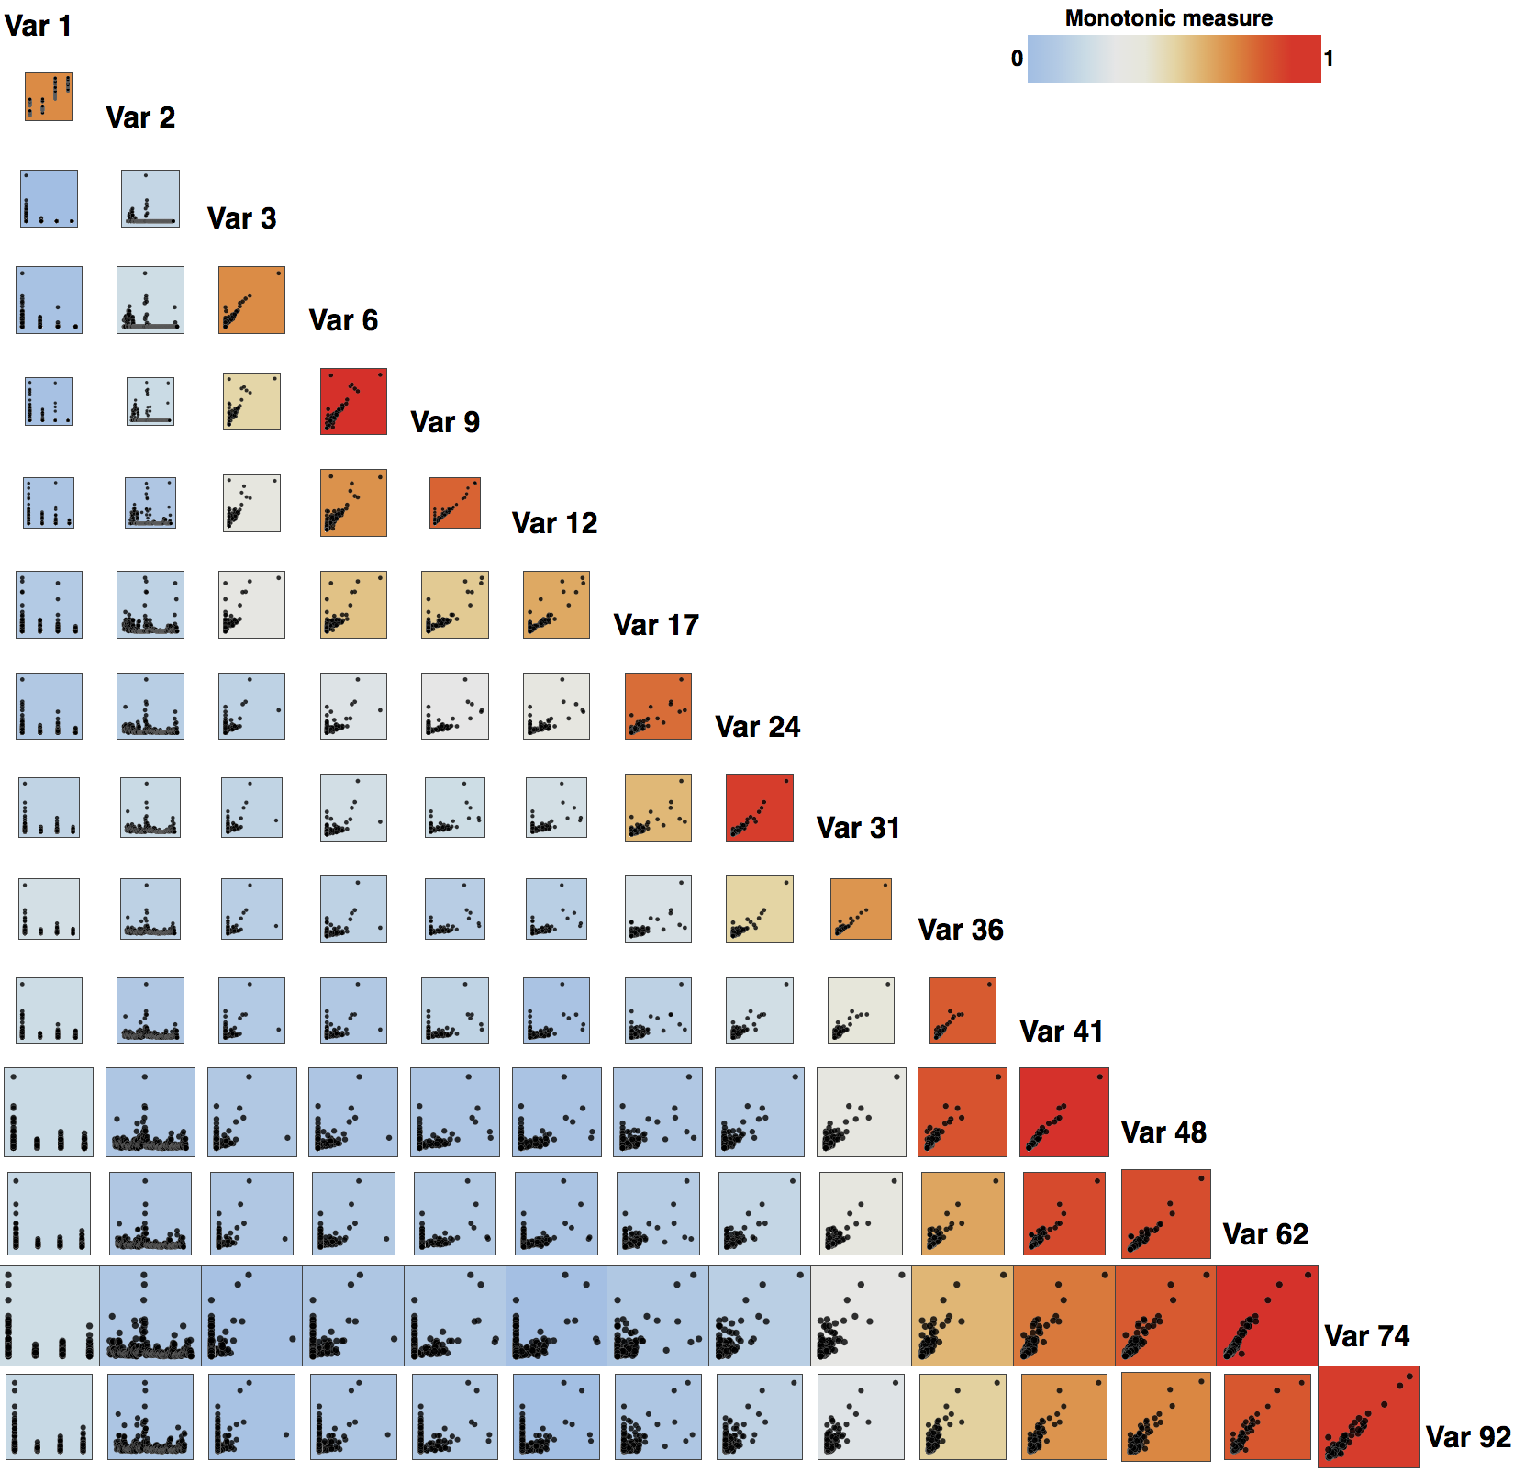
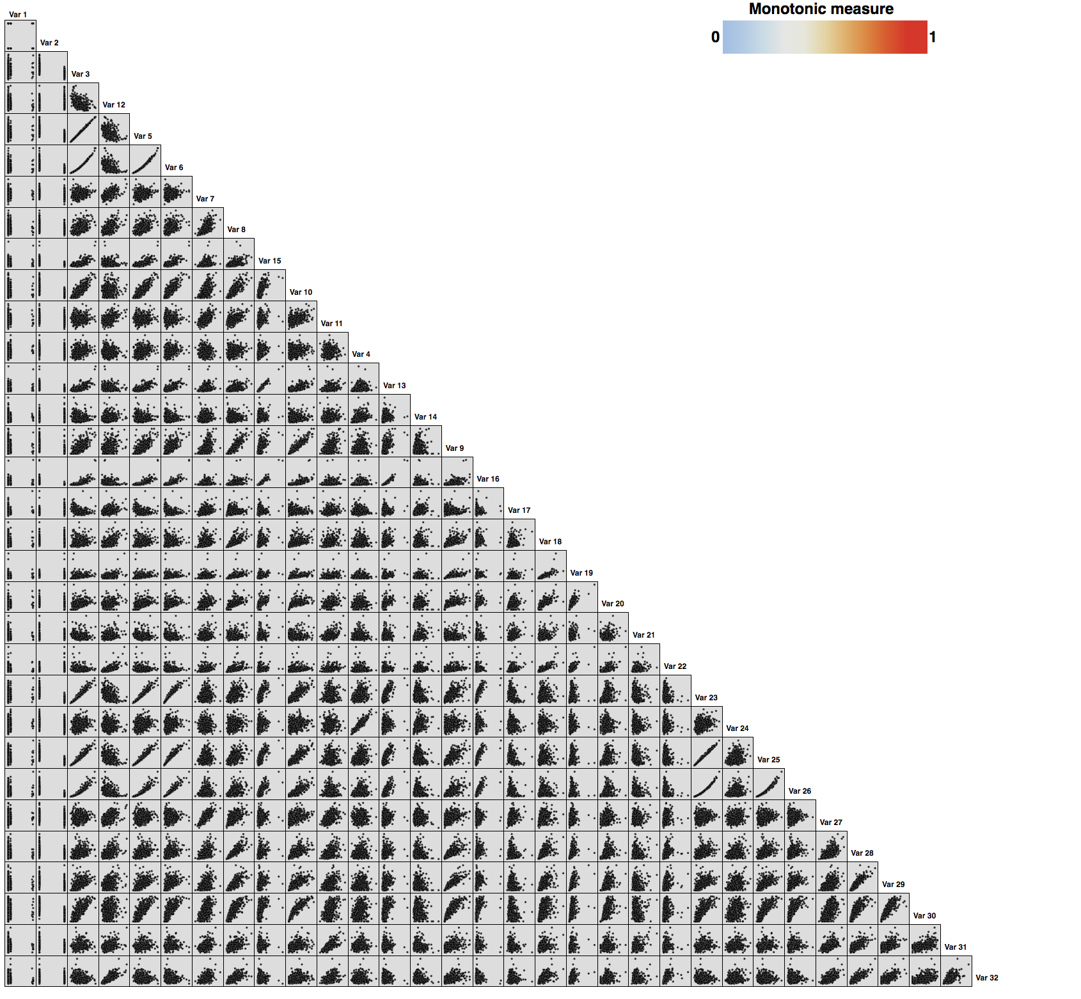
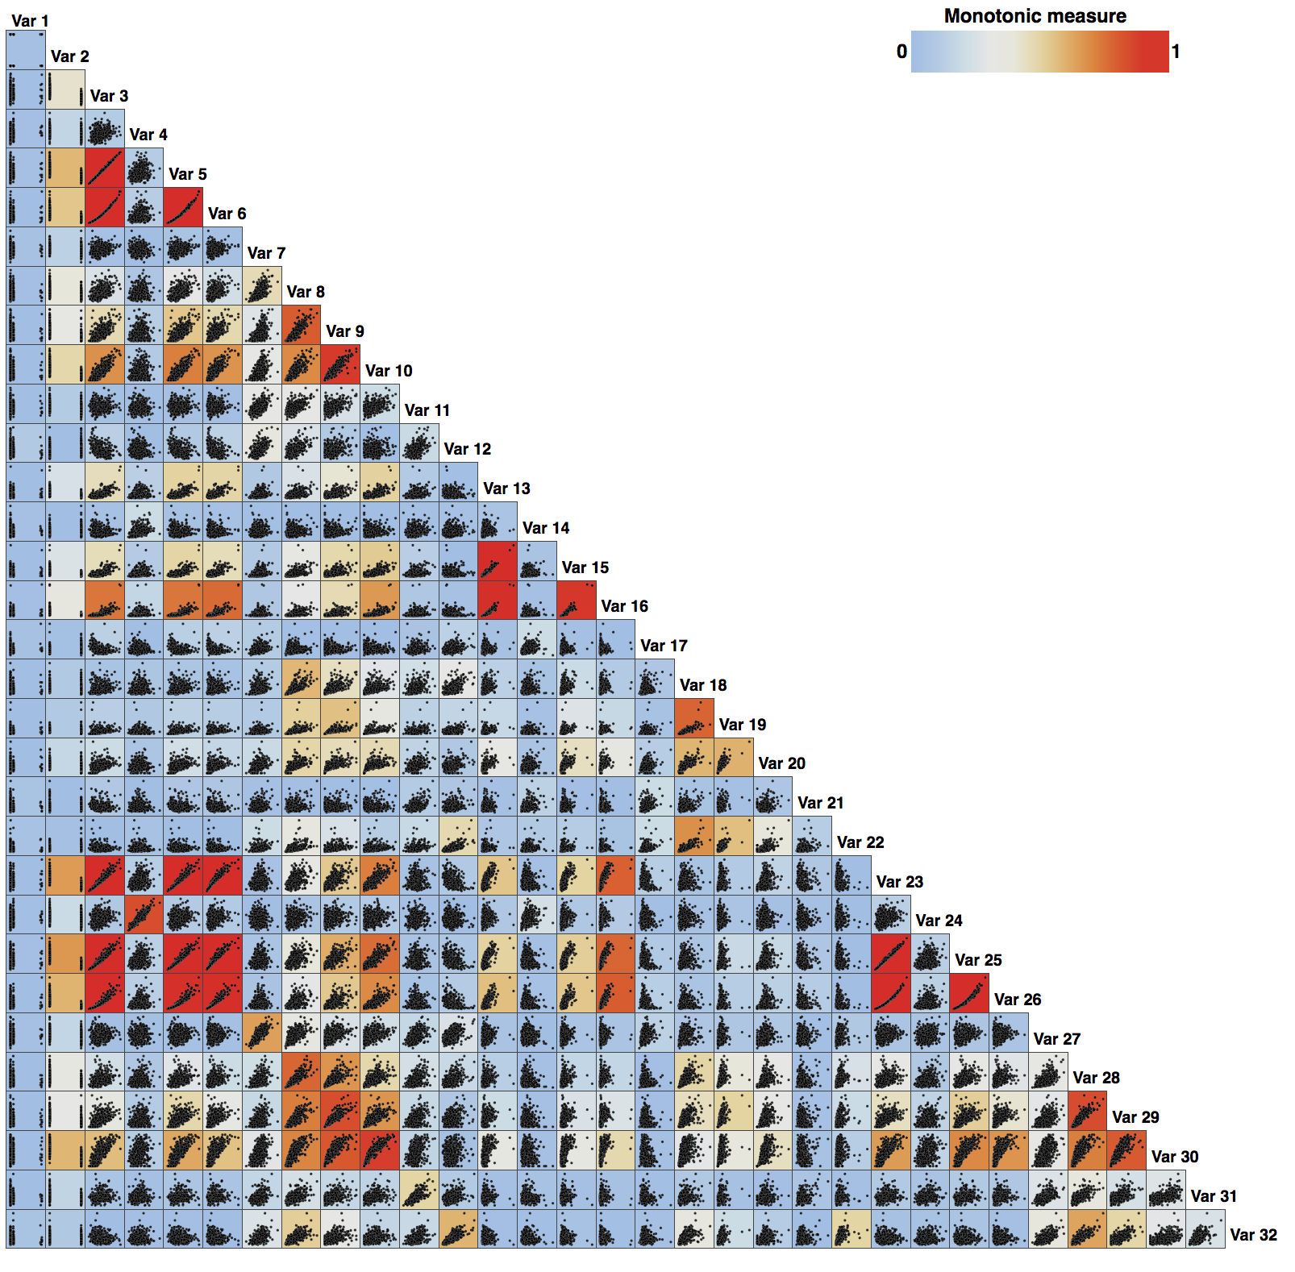
Compute Scagnostics
Select Variables
Original SPLOM
SPLOM colored by Monotonicity
Clustered SPLOM

Slide 2
Compute Scagnostics
Select Variables
Original SPLOM
SPLOM colored by Monotonicity
Clustered SPLOM

Slide 3
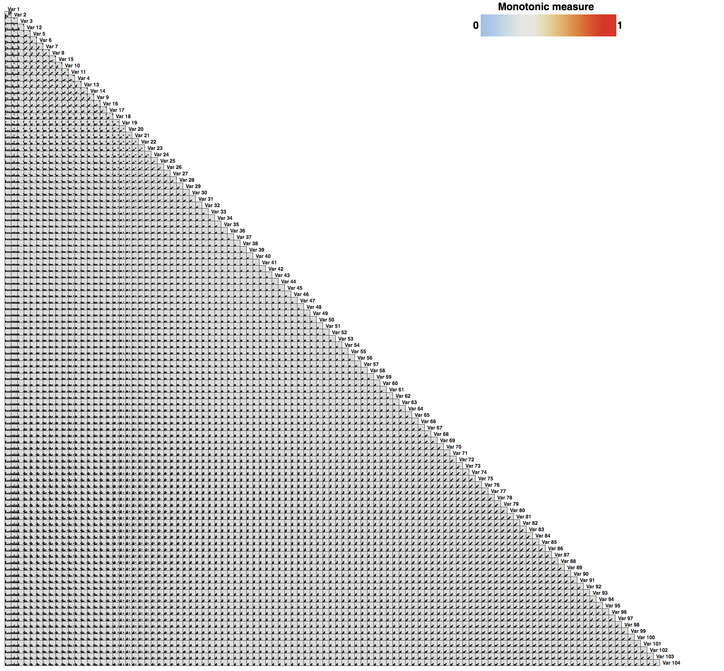
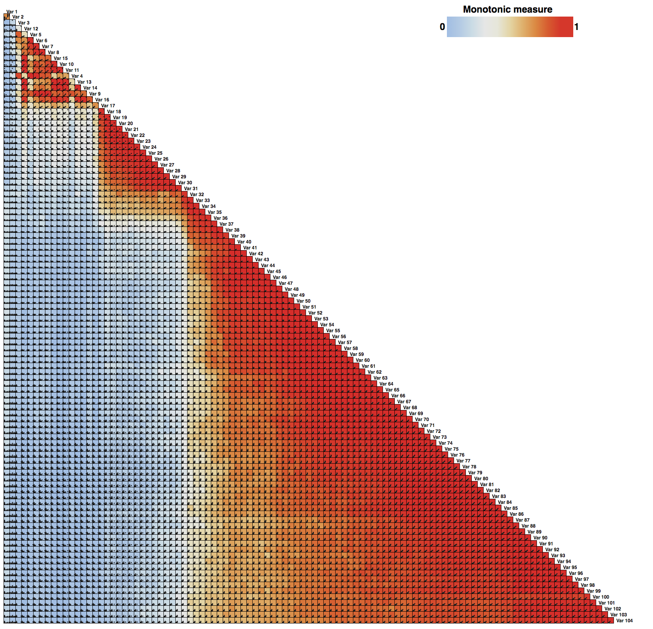
Compute Scagnostics
Select Variables
Original SPLOM
SPLOM colored by Monotonicity
Clustered SPLOM

Slide 4
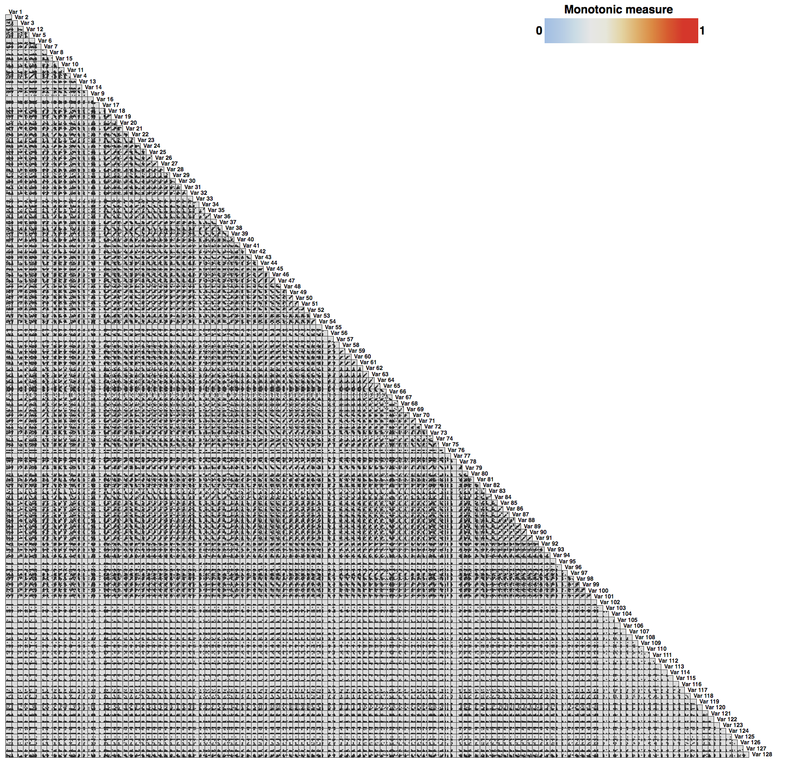
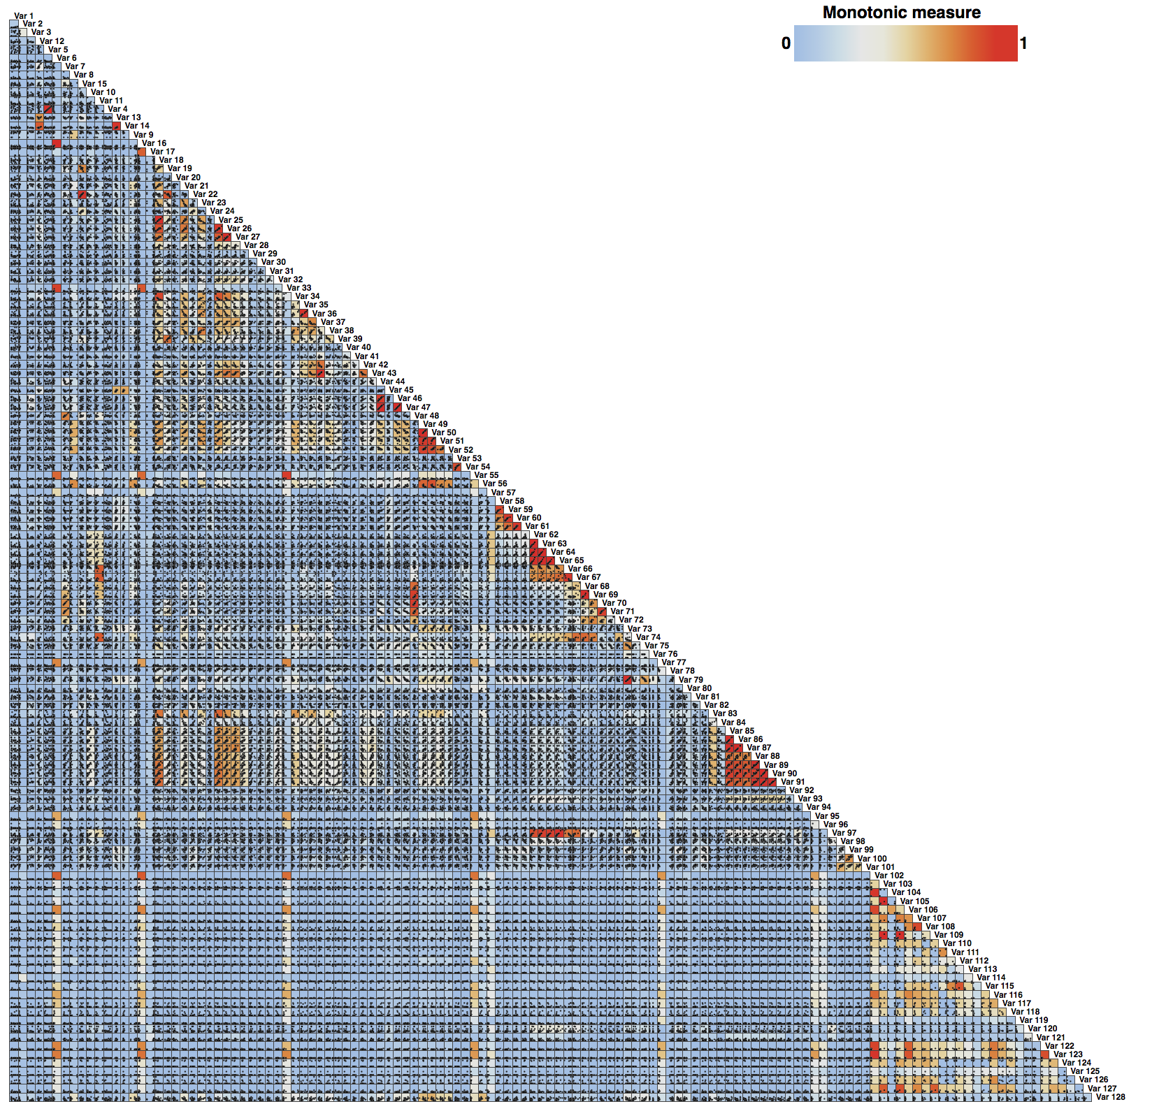
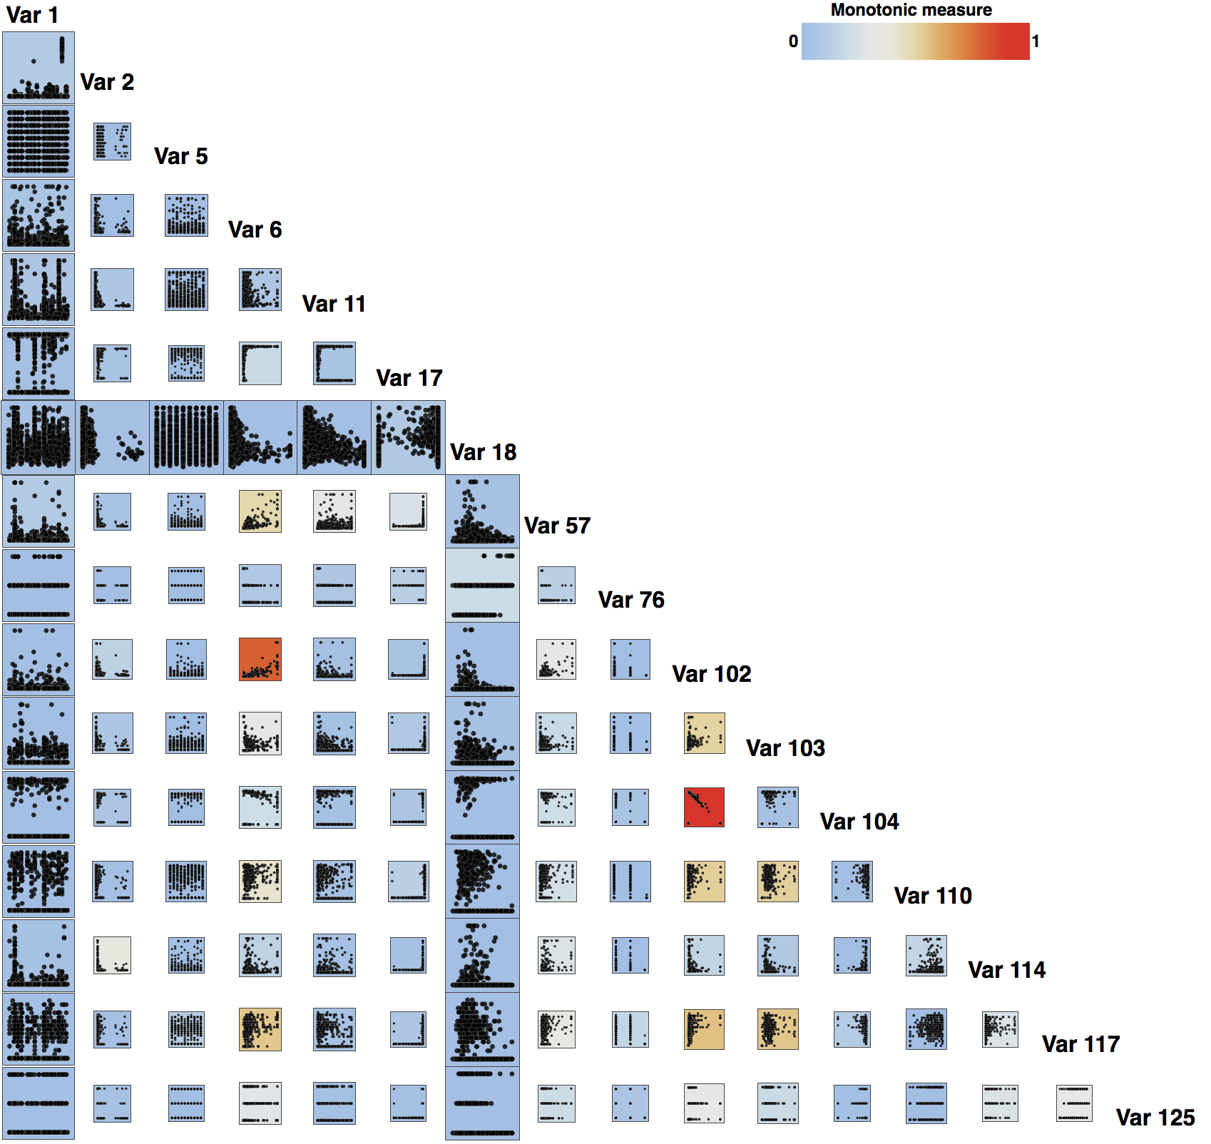
Compute Scagnostics
Select Variables
Original SPLOM
SPLOM colored by Monotonicity
Clustered SPLOM

Slide 5
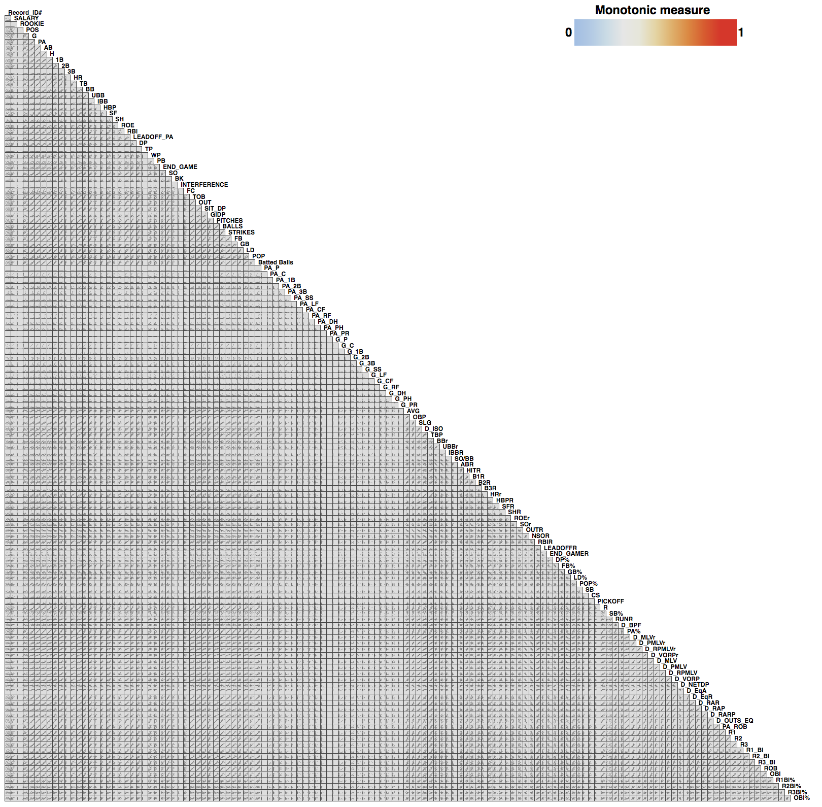
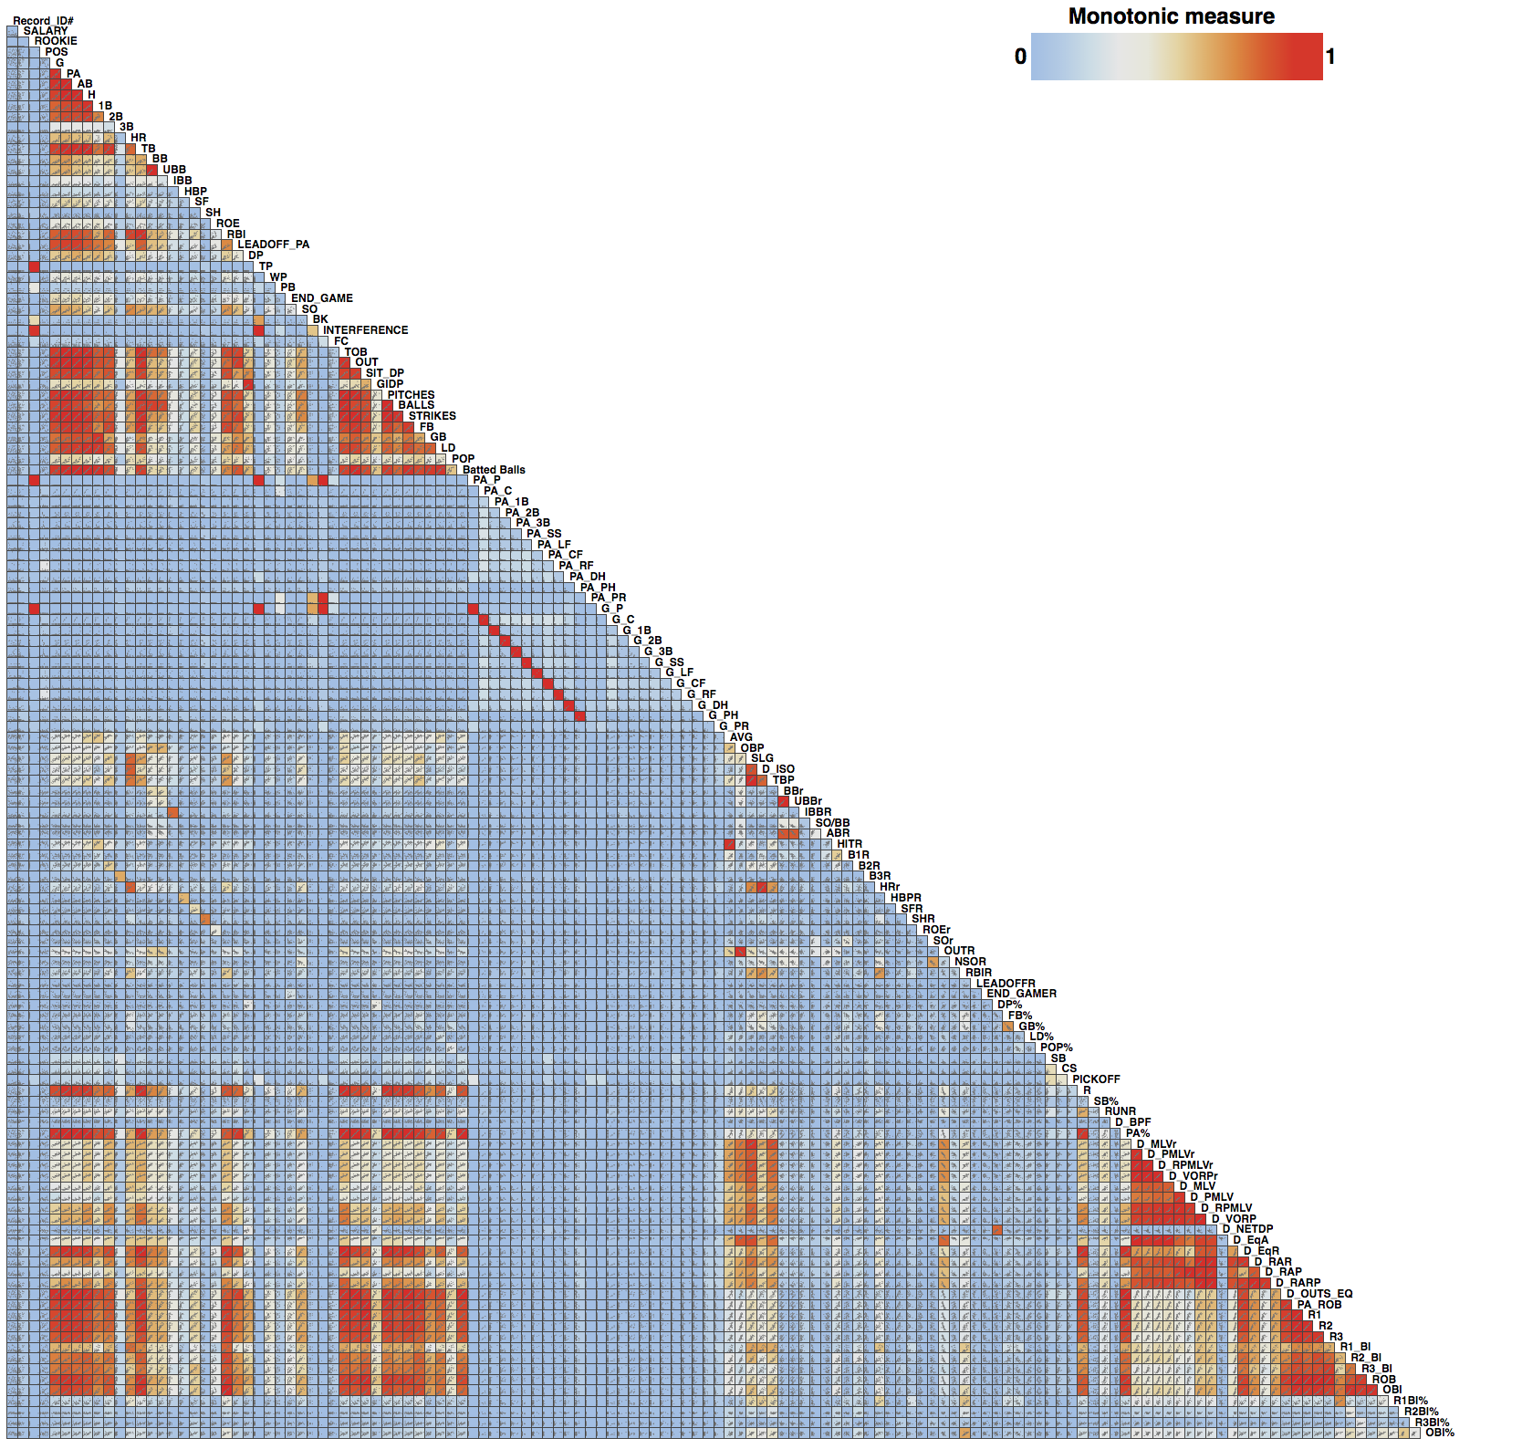
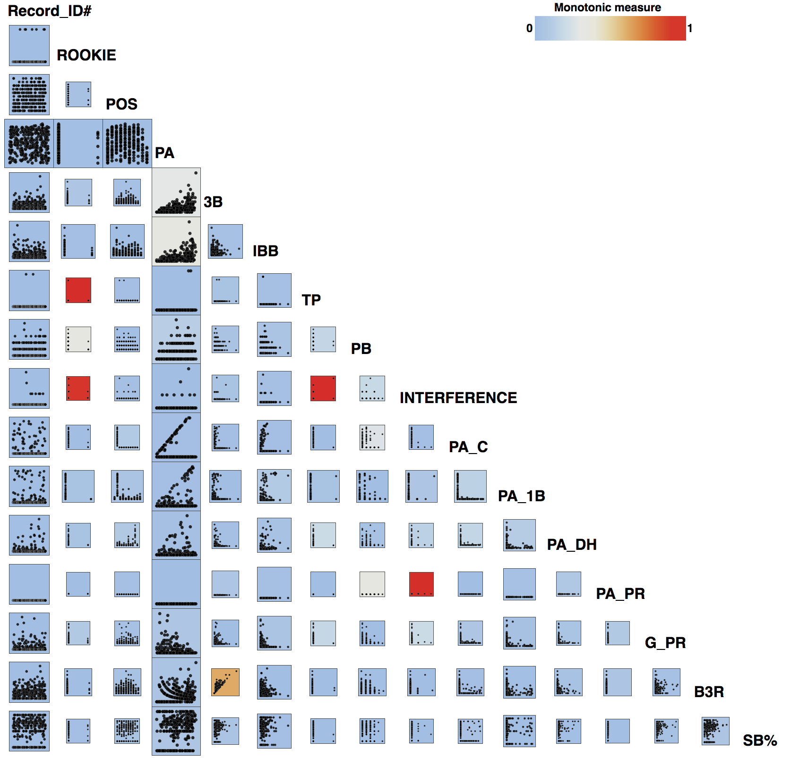
Compute Scagnostics
Select Variables
Original SPLOM
SPLOM colored by Monotonicity
Clustered SPLOM

